Slide 1
GEORGETOWN UNIVERSITY
DATA SCIENCE COHORT 12
TEAM BOX OFFICE

Slide 2


Slide 3
TEAM BOX OFFICE
Hypothesis: Based on movie data from 1995 to mid-2018, we will try to
determine which features and attributes of a movie best predict its worldwide box office revenues and profitability.

Slide 4
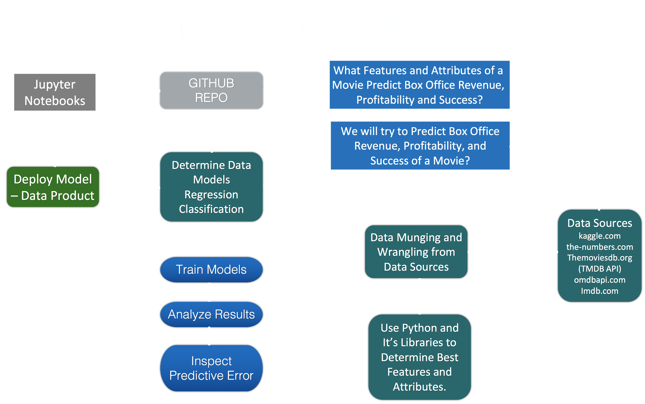

Slide 5
PROJECT CRITERIA
Movies must be released in theaters
Box office revenue should be worldwide revenue
Non-theater revenue from DVD sales or on demand video are not included.
Movies should be primarily in English

Slide 6
LITERATURE REVIEW
Some papers describe attempts at linear regressions to predict box office revenue
R-squared tends to be in .40 range
Important variables range from budget, MPAA rating, genre, past profitability of director/cast
Other general research showed that movies have significant costs beyond just production costs (e.g., marketing, distribution)
Movies that earn hundreds of million of dollars may still not turn a profit
Some use a rule-of-thumb where a movie may have earned a profit if it has earned back at least twice its production budget.

Slide 7










DATA SOURCES

Slide 8
PRIMARY DATA SOURCES
Kaggle data set, comprised MovieLens data (our base file)
Kaggle data set, movies from The Movies Database
The-Numbers.com
Open Movie Database (OMDB API)
The Movies Database (TMDB API)
The primary data sources included some combination of features like revenue, budget, cast, crew, genres, length, plot, tagline, keywords, company, and ratings.

Slide 9
SECONDARY DATA SOURCES
Google searches for 2017 and 2018 movies.
IMDB and Rotten Tomatoes, for verifying some data
Our primary data sources did not include movies post 2016. We decided to add those movies and their features to make our data set more up-to-date.

Slide 10



DATA WRANGLING
Data munging and wrangling
Data cleaning
Missing Data

Slide 11
JOINING DATA SETS
Of the dozen data files we gathered or created, most were easy to join by using movie ID columns.
Data from the-numbers.com did not have movie ID, so used movie name and year of release to join.
Due to differences in release dates and movie name/spelling, some duplicates were introduced
After joining all data files, we had almost 100 columns of data and ~20,000 rows of movies.
Several columns were of similar features. Merging process will be described subsequently.

Slide 12
PARSING DATA
Some columns of data were JSON formats that looked like this:
or this:
“[{'Source': 'Internet Movie Database', 'Value': '8.3/10'}, {'Source': 'Rotten Tomatoes', 'Value': '100%'}, {'Source': 'Metacritic', 'Value': '95/100'}]”
“[{'credit_id': '52fe4284c3a36847f8024f49', 'department': 'Directing', 'gender': 2, 'id': 7879, 'job': 'Director', 'name': 'John Lasseter', 'profile_path': '/7EdqiNbr4FRjIhKHyPPdFfEEEFG.jpg'}, {'credit_id': '52fe4284c3a36847f8024f4f', 'department': 'Writing', 'gender': 2, 'id': 12891, 'job': 'Screenplay', 'name': 'Joss Whedon', 'profile_path': '/dTiVsuaTVTeGmvkhcyJvKp2A5kr.jpg'}, {'credit_id': '52fe4284c3a36847f8024f55', 'department': 'Writing', 'gender': 2, 'id': 7, 'job': 'Screenplay', 'name': 'Andrew Stanton', …….

Slide 13
PARSING DATA
Those types of columns were first converted into an actual list of dictionaries, and then parsed to collect values.
Either new columns would be created or existing columns would be replaced with a simple list of strings
i.e., [‘Joss Whedon', 'Andrew Stanton’] as the writers of a movie.
i.e., [‘Action’, ‘Drama’] as the genres of a movie.

Slide 14
MERGING SIMILAR DATA
We were left with roughly 100 columns during the joining process, and we had to combine any similar columns/features to have a compact and meaningful data set.
Each group of columns that contained a similar feature were combined using various algorithms, for example:
Revenue: Pick the maximum number in all related columns
Budget: Pick the average number
Length/Ratings: Pick the average number
Genre/Company/Keywords/Director/Writer/Producer: Create a list to get a union of all genres
Actors: Create a list, but keep order of importance
Release Date: Pick earliest release date.

Slide 15
REVIEW MERGED DATA
After this process, we reduced the data set down to 30 columns.
An initial count of missing values in each column showed upwards of 10,000 out of 20,000 rows were missing some values, including revenue.
Our team took a look at a few years of data and discovered most of the movies missing information, like revenue, were movies not released in theaters.
We then automatically deleted movies with no revenue, but wanted to manually check movies in 2017 and 2018 before deleting.
We also decided to attempt to verify the information for the remaining movies pre-2017.
Our data sources did not consistently report whether revenues were domestic or global.
Also a good way to mark duplicates for movies with slightly different spellings or release dates
Managed to verify movies from 2008-2018

Slide 16


DATA STORAGE
Files from original data sources were only stored locally on disk and imported into Pandas dataframes when being used.
But the merged data set we created was stored in a table in an SQLite Database.
Data set was roughly 6,000 movies

Slide 17
PRE-PROCESSING DATA
The merged data set contains data types that could not be used directly in models, like lists of strings, categorical data, or text data.
First, several binary variables were created to make certain features usable:
GENRE:
Drama
Comedy
Action/Adventure
Thriller/Horror
Romance
Crime/Mystery
Animation
Scifi
Documentary
Other
RATED:
G/PG
PG-13
R
Other
DATE/SEASON:
Spring
Summer
Fall
Winter
Holiday
COMPANY:
Disney
Dreamworks
Fox
Lionsgate
MGM
Miramax
Paramount
Sony
Universal
Warner Bros
Other

Slide 18
PRE-PROCESSING DATA
Features with dollar amounts had to be deflated
Revenue and Budget were converted to June 2018 dollars using headline U.S. CPI.
A Profit feature was generated taking the difference.
Additional features related to Profit were also created:
Revenue divided by Budget tells you how many multiples of the production budget were earned back:
<1x
[1-2x)
[2-3x)
[3-4x)
[4-5x)
>=5X

Slide 19
PRE-PROCESSING DATA
In order to use columns that contained lists of Actors, Directors, Writers, and Producers, we calculated the running sum of historical revenues earned by a given movie’s cast or crew.
Any missing Rotten Tomatoes, IMDB, and Metacritic ratings were imputed by first using any other available rating for that given movie, or by using the median of rating in the entire data set.
Converted Awards column from text to numbers:
“Won 6 Oscars. Another 117 wins & 126 nominations.”
“3 wins & 4 nominations.”
Converted to major/minor wins/nominations.
After all the pre-processing, this “final” data set was stored in another table in the SQLite database.

Slide 20
LIST OF FEATURES
NUMERICAL:
Revenue
Budget
Profit
Revenue Actor
Revenue Director
Revenue Writer
Revenue Producer
Length
Rotten Tomatoes Rating
IMDB Rating
Metacritic Rating
IMDB Votes*
Major/Minor Nominations*
Major/Minor Wins*
LISTS/CATEGORICAL/BINARY:
Actors
Directors
Writers
Producers
Genres
Production companies
Rated
Season
Part of Collection
TEXT
Keywords
Tagline
Plot
Overview
*IMDB votes and awards won’t be available before movie’s release

Slide 21
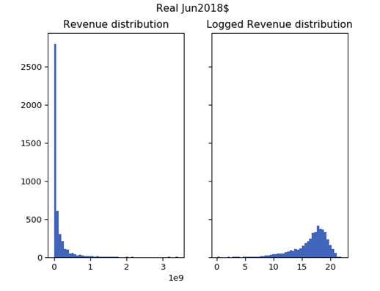
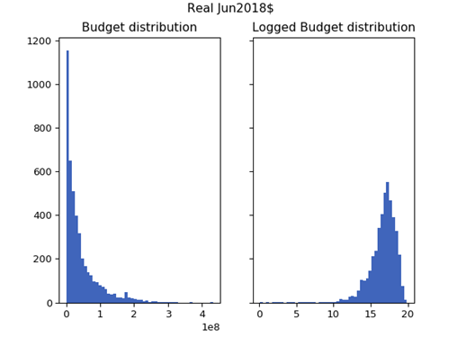
DATA EXPLORATION
Revenue
Budget

Slide 22
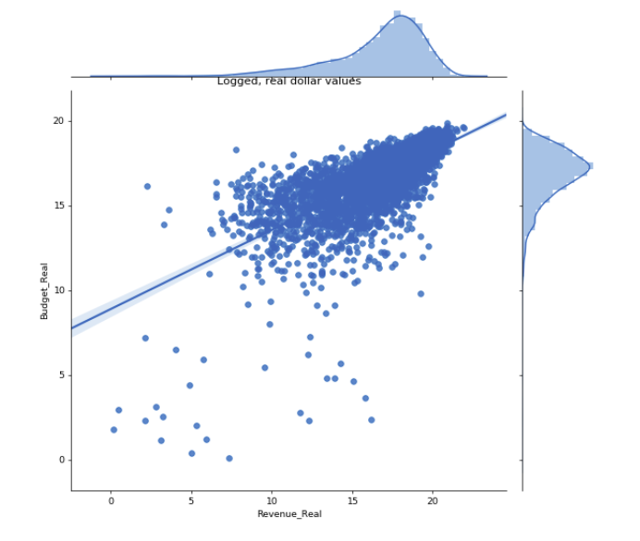
DATA EXPLORATION
Logged, Real Budget
Logged, Real Revenue

Slide 23
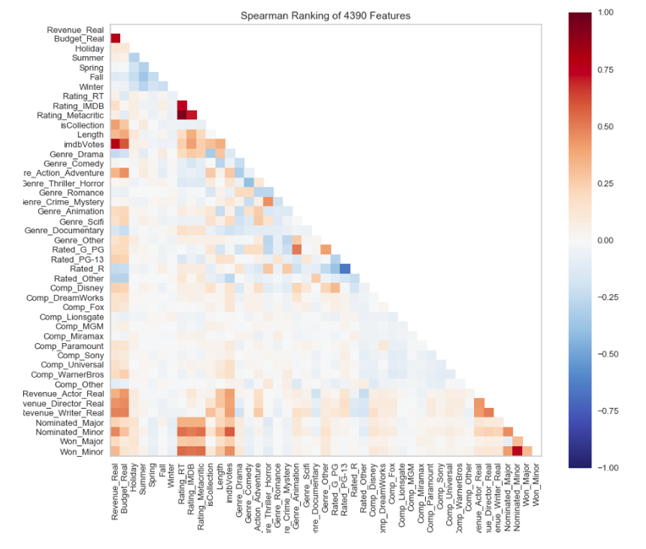
DATA EXPLORATION
Revenue is strongly positively correlated with:
Budget
IMDB Votes
Screenwriter revenue
Minor award nominations
Part of collection
Revenue is negatively correlated with:
Rated R or Other
Drama

Slide 24
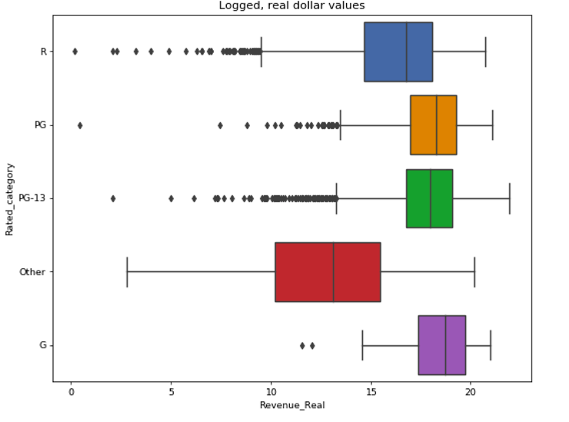
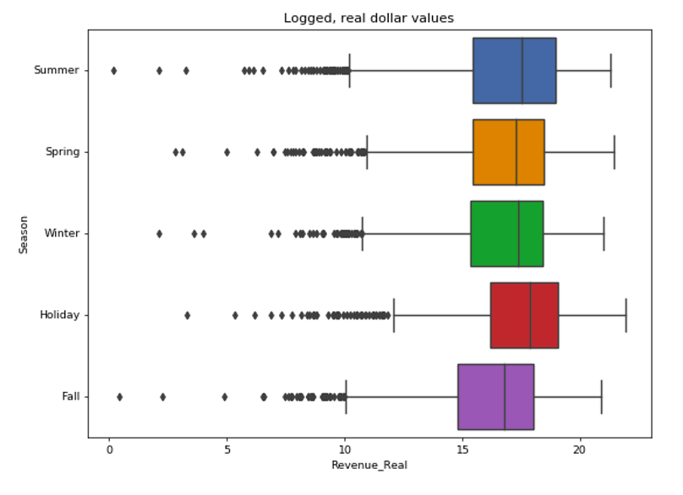
DATA EXPLORATION
Logged Revenue by MPAA Rating
Logged Revenue by Season

Slide 25
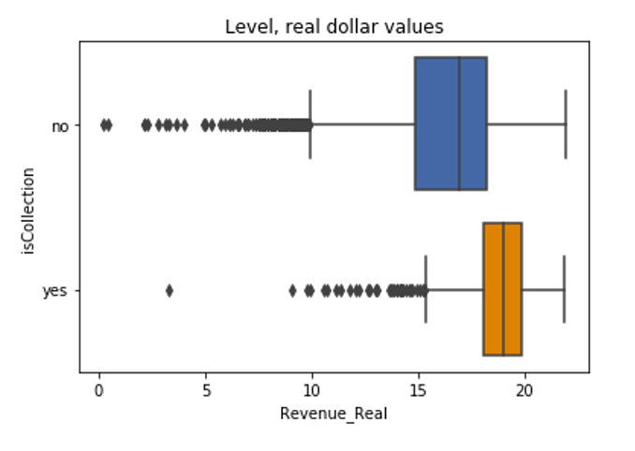
DATA EXPLORATION
Logged Revenue by Whether Movie is Part of Collection

Slide 26
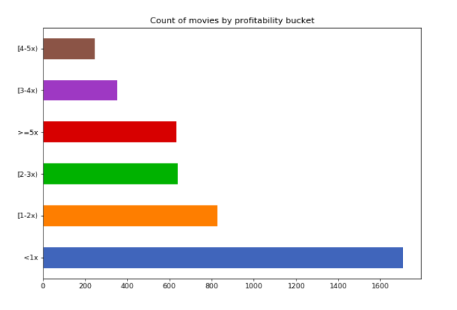
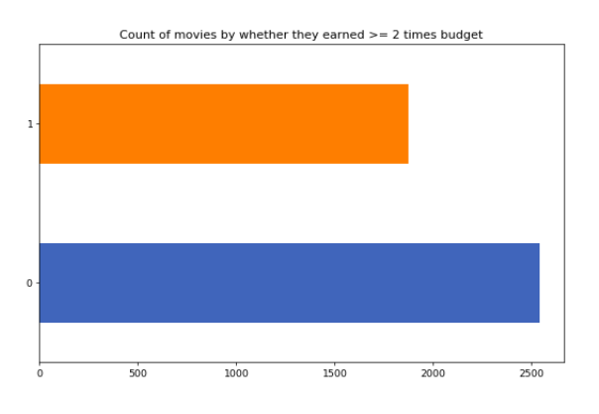
DATA EXPLORATION
6 Profit Buckets
2 Profit Buckets
~39% of movies do not earn back its production budget
~58% of movies do not earn at least twice its production budget

Slide 27
DATA MODELING
Two different modeling approaches were used.
Regression models:
Predict deflated box office revenue
Used logged values of any dollar amounts
Using logs restricted data set to 1,879 movies
Classification models:
Predict whether a movie earned at least twice its production budget
Data set of 4,414 movies
Experiment with shorter time period

Slide 28
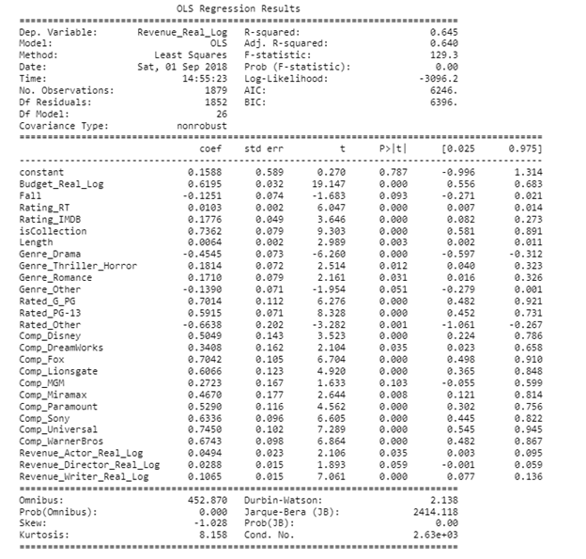
REGRESSION MODELS
Initial observations:
R-squared not bad at 0.65
Budget is important
No season variable is significant
Dramas have negative coefficient
Screenwriters’ historical revenues more important than actors’ or directors’

Slide 29
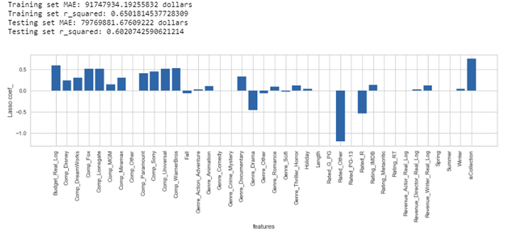
REGRESSION MODELS
Split data set into train/test sets and used regularization models: Ridge, Lasso, and ElasticNet
All generally had R-squareds of around 0.62 and mean absolute errors of $80,000,000.
Chose Lasso model, which had slightly higher R-squared after using 10-fold CV
Important variables:
Part of collection
Budget
Rated R or Other
Drama
Companies

Slide 30
CLASSIFICATION MODELS
Classification = 1, if movie made at least twice its budget
A variety of classification models were initially tested.
Arbitrary F1 score cut off at 0.60 for correctly classifying when movie is profitable.
Performed further 10-fold CV to ensure those models performed same with different train/test sets.
Left with Logistic Regression, Random Forest, Ada Boost, XGB Classifier, Gradient Boosting, and MLP Classifier
Performed hyperparameter tuning for most of these models.

Slide 31
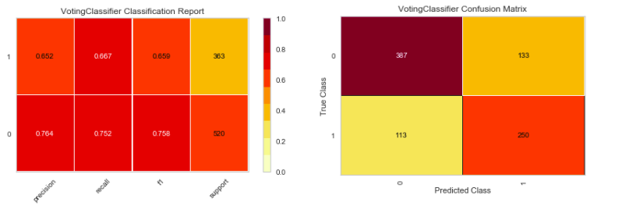
CLASSIFICATION MODELS
The optimal models were then put into a Voting Classifier and a final grid search was performed.
Grid Search showed voting should be set to “hard”
Only Random Forest, XGB Classifier, and MLP Classifier should be included.
Classification of 1 had F1 score = .66. Classification of 0 had F1 score of .76.

Slide 32
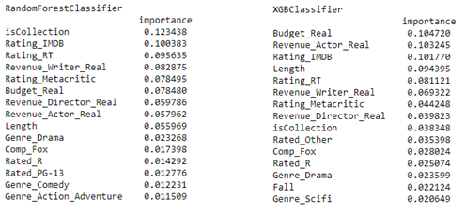
CLASSIFICATION MODELS
A look at feature importances of the optimal Random Forest and XGB Classifier.

Slide 33
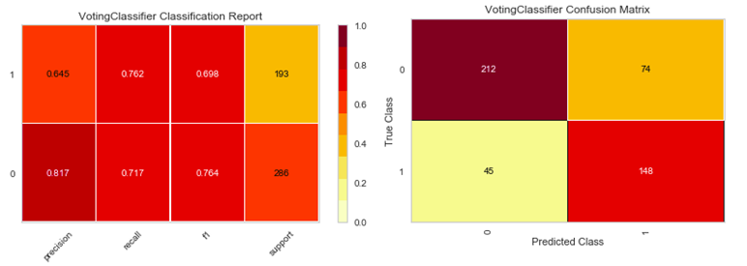
CLASSIFICATION MODELS, SHORTER TIME FRAME
Tested a shorter sample period of 2008-2018. Same steps were repeated with 2,395 movies.
Grid Search on Voting Classifer showed voting should be set to “soft”
Only Random Forest, XGB Classifier, and Ada Boost should be included.
Classification of 1 had F1 score = .70. Classification of 0 had F1 score of .76.

Slide 34
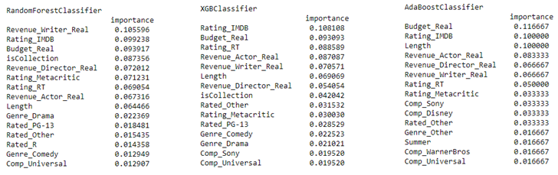
CLASSIFICATION MODELS, SHORTER TIME FRAME
A look at feature importances of the optimal Random Forest, XGB Classifier, and Ada Boost.

Slide 35
SUMMARY
We were able to develop regression models that could account for ~65% of the variation in box office revenues.
We were able to develop classification models that had F1-scores of around 0.70 when trying to predict if a movie was profitable.
Interesting findings:
Having movie budgets really helped.
Whether a movie is a part of a collection was important in many models.
Screenwriters’ historical revenue was more important than expected.
Time of year of release wasn’t important.
Shortening the time period for the classification models improved scores.

Slide 36
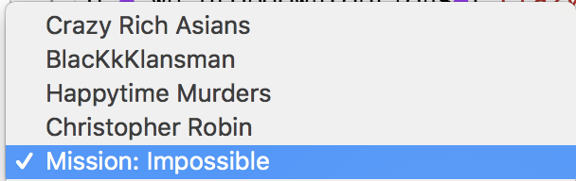
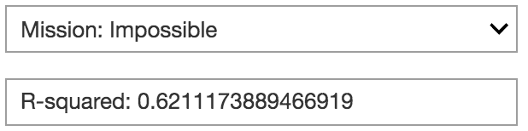
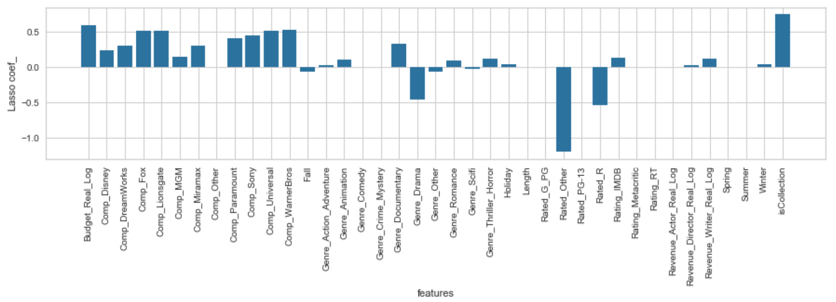
DATA PRODUCT
George - The output of the regression model in the data product will be the actual revenue we predict. LIke $900,000,000,
No R-squareds or coefficients are involved when actually using a model to do predictions. Those are only used when you’re building the model
Regression Model
When Selecting a Movie from the Dropdown list , the movie will provide an R-squared score and plot the features.

Slide 37
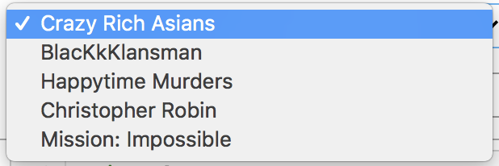
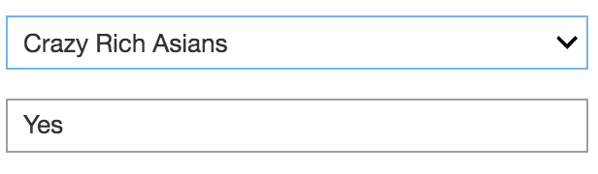
DATA PRODUCT
Classification Model
When Selecting a Movie from the Dropdown list:
The output will be either Yes or No. YES, if the movie will be successful and NO, if the movie will not make 2 times (*) its budget.

Slide 38
DATA PRODUCT - IDEAL
Our ideal data product would be for us to have an User-Interface where,
If there is a data feed from our data sources, the user would just have to enter the name of the movie to get results.
For Example, Movie Name = Night School
If there is no data loaded in the database for the new movie, enter:
Budget Actress/Actor Genre Metacritic Rating
Director’s Name MPAA Rating Season Movie Length
Writer’s Name IMDB Rating Rotten Tomatoes% Company

